Slide 1
Ordering Integers
Mr Parekh

Slide 2
Learning Objectives
Students will be able to,
Order integers in ascending and descending orders.
Plot given numbers on the number line.

Slide 3
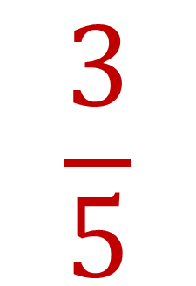








Coordinates
Interactive Notebook
$$×$$
$$\frac{1}{2}$$
$$÷$$
$$+$$
$$\frac{3}{5}$$
$$−$$
$$7$$
$$5^{2}$$
$$\sqrt{9}$$
Name
Class
Teacher
Term 1 Semester 1
1

Slide 4
Contents
Glossary or Formula Page
Page
Date
Description
2
3

Slide 5
24
7
30
Tasks
Essential Question
Questions
Notes
Summary

Slide 6
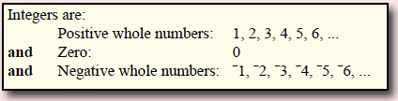

24
7
30
Date
Integers
EQ – What are integers and how do I know which one is bigger?
Integers can be put on a number line.
Positive integers are on the right side of the zero.
Negative integers are on the left side of the zero.
Negative
Positive
Notes:
Ask student to write questions for the notes.
Model Chunking of notes.

Slide 7
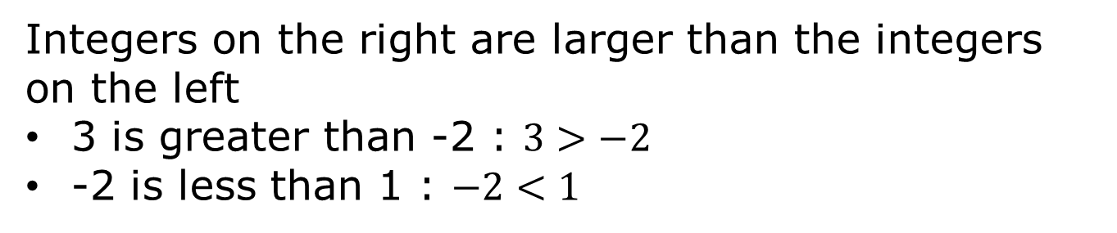
24
7
30
Date
Integers
EQ – What are integers and how do I know which one is bigger?
Integers can be put on a number line.
Positive integers are on the right side of the zero.
Negative integers are on the left side of the zero.
Negative
Positive
Integers on the right are larger than the integers on the left
3 is greater than -2 : $3>−2$
-2 is less than 1 : $−2<1$

Slide 8
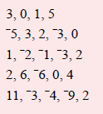
Activity
Place the following numbers on the number line and arrange the number in the ascending order (smallest to largest).
Notes:
Make groups of student with 4 or 5 students.
Hand out a A3 sheet of number line and a sticky notes for the numbers.
Ask students to put the number on sticky notes and place them on the number line.
Ask them to write the numbers in the ascending order.

Slide 9
Independent Practice
Arrange this group of number in the ascending order (Smallest to largest).
Notes:
Ask student to attempt this questions individually.

Slide 10

Guided Practice
Copy each pair of numbers and place the correct < or > between them.
Notes:
Answer couple of questions for the student.

Slide 11
Closure
Exit pass.
Complete the summary.

